Slide 1
Recent Development of Global Self-Optimizing Control
Lingjian Ye, Yi Cao
Ningbo Institute of Technology
Cranfield University
LCCC Process Control Workshop
28th October 2016

Slide 2
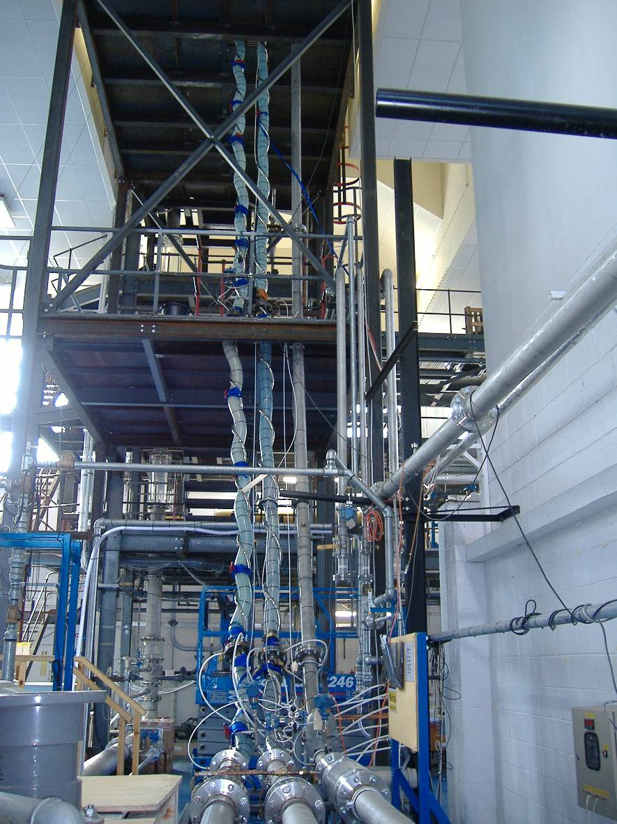
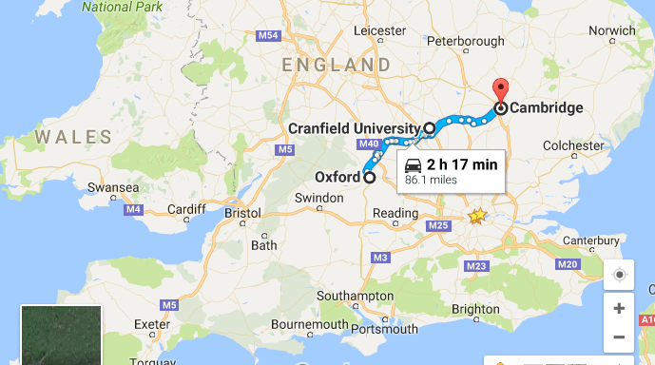
Cranfield University
Location: “linear combination” of Cambridge and Oxford
Postgraduate only university
University has an airport
Industrial scale facilities

Slide 3
Outline
Self-optimizing control (SOC) problem
Brute force approach and local approaches
Global self-optimizing control (gSOC)
  Gradient regression approach
  Controlled variable adaptation
  Optimal data based approach
  Subset measurement selection
  Retrofit SOC
Case studies
Conclusions

Slide 4

Self-optimizing control problem
VALTEK
Relevant problems: Inferential Control, Indirect Control

Slide 5
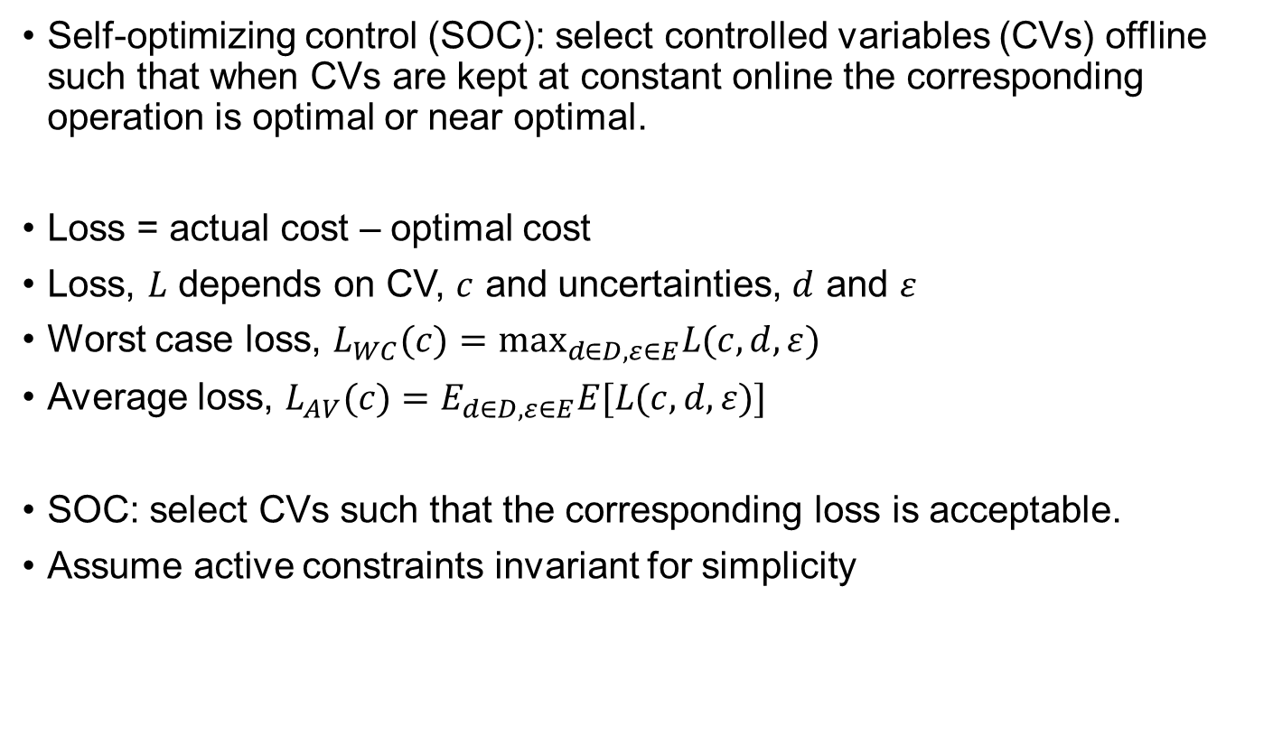
Self-optimizing control problem
Self-optimizing control (SOC): select controlled variables (CVs) offline such that when CVs are kept at constant online the corresponding operation is optimal or near optimal.
Loss = actual cost – optimal cost
Loss, $L$ depends on CV, $c$ and uncertainties, $d$ and $ε$
Worst case loss, $L_{WC}(c)={\text{max}}_{d∈D,ε∈E}L(c,d,ε)$
Average loss, $L_{AV}(c)=E_{d∈D,ε∈E}E[L(c,d,ε)]$
SOC: select CVs such that the corresponding loss is acceptable.
Assume active constraints invariant for simplicity

Slide 6
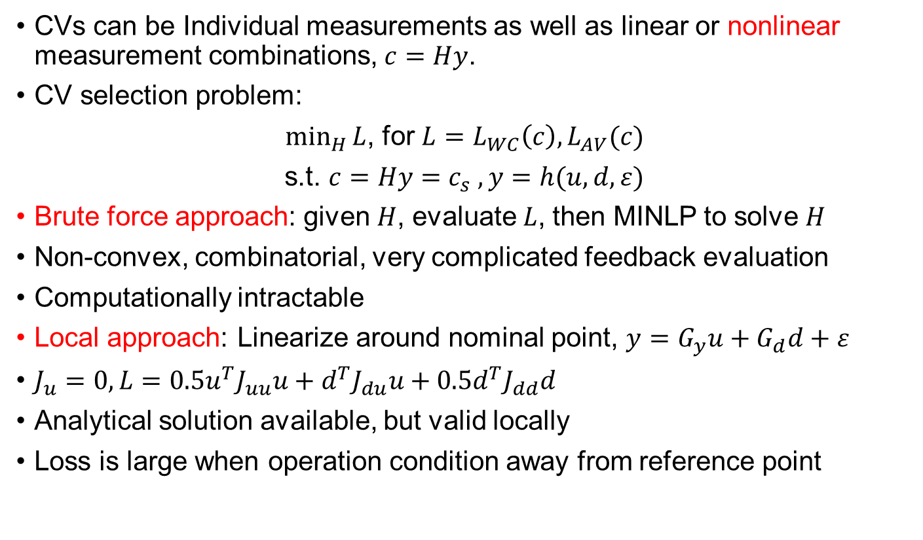
Optimal CV selection approaches
CVs can be Individual measurements as well as linear or nonlinear measurement combinations, $c=Hy$.
CV selection problem:
$\min_{H}{L}$, for $L=L_{WC}\left(c\right), L_{AV}(c)$
s.t. $c=Hy=c_{s} , y=h(u,d,ε)$
Brute force approach: given $H$, evaluate $L$, then MINLP to solve $H$
Non-convex, combinatorial, very complicated feedback evaluation
Computationally intractable
Local approach: Linearize around nominal point, $y=G_{y}u+G_{d}d+ε$
$J_{u}=0, L=0.5u^{T}J_{uu}u+d^{T}J_{du}u+0.5d^{T}J_{dd}d$
Analytical solution available, but valid locally
Loss is large when operation condition away from reference point

Slide 7
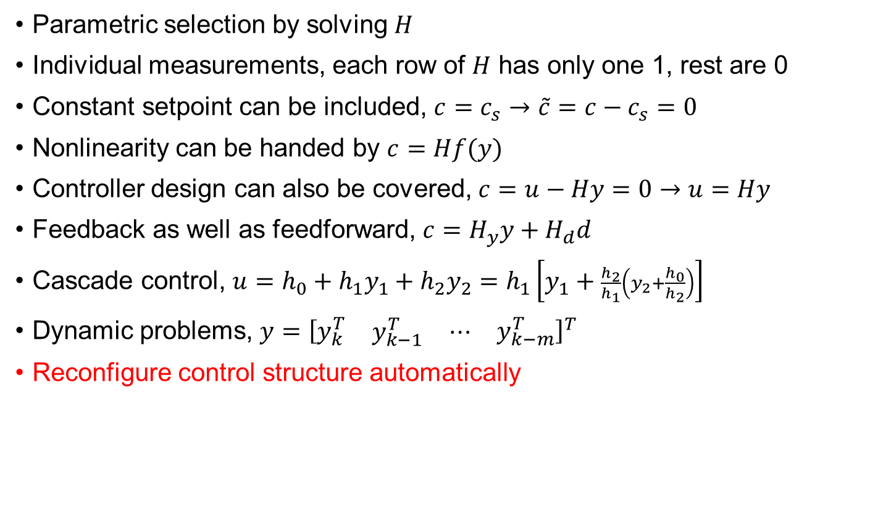
Controlled variable, c = Hy
Parametric selection by solving $H$
Individual measurements, each row of $H$ has only one 1, rest are 0
Constant setpoint can be included, $c=c_{s}→\tilde{c}=c−c_{s}=0$
Nonlinearity can be handed by $c=Hf(y)$
Controller design can also be covered, $c=u−Hy=0→u=Hy$
Feedback as well as feedforward, $c=H_{y}y+H_{d}d$
Cascade control, $u=h_{0}+h_{1}y_{1}+h_{2}y_{2}=h_{1}\left[y_{1}+\frac{h_{2}}{h_{1}}\left(y_{2}+\frac{h_{0}}{h_{2}}\right)\right]$
Dynamic problems, $y={\left[\begin{matrix}y_{k}^{T} & \begin{matrix}y_{k−1}^{T} & ⋯\end{matrix} & y_{k−m}^{T}\end{matrix}\right]}^{T}$
Reconfigure control structure automatically

Slide 8
Global self-optimizing control (gSOC)
Can we have a tractable algorithm to solve CV selection problem globally?
Solution: model →data →solution
Loss due to measurement uncertainty can be decoupled from loss due to disturbances
Collect global data through Monte Carlo simulation over entire operation region of disturbances
Select optimal CV based on global data collected.

Slide 9
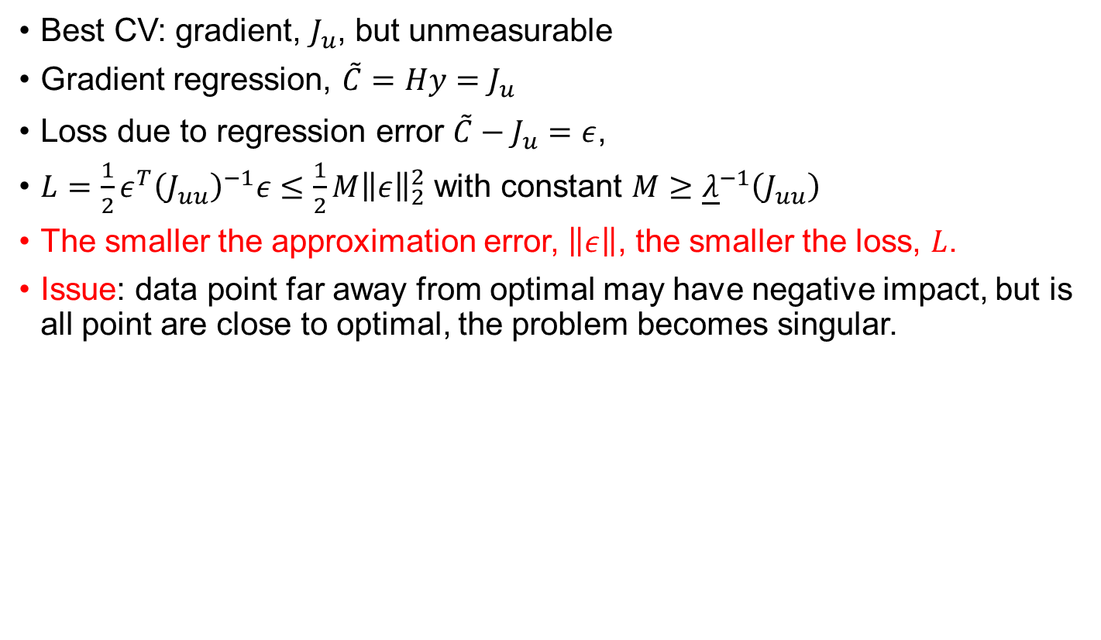
gSOC: gradient regression
Best CV: gradient, $J_{u}$, but unmeasurable
Gradient regression, ${\tilde{C}=Hy=J_{u}}_{}$
Loss due to regression error $\tilde{C}−J_{u}=ε$,
$L=\frac{1}{2}ε^{T}{\left(J_{uu}\right)}^{−1}ε≤\frac{1}{2}{M\left\|ε\right\|}_{2}^{2}$ with constant $M≥{\underline{λ}}^{−1}\left(J_{uu}\right)$
The smaller the approximation error, $\left\|ε\right\|$, the smaller the loss, $L$.
Issue: data point far away from optimal may have negative impact, but is all point are close to optimal, the problem becomes singular.

Slide 10
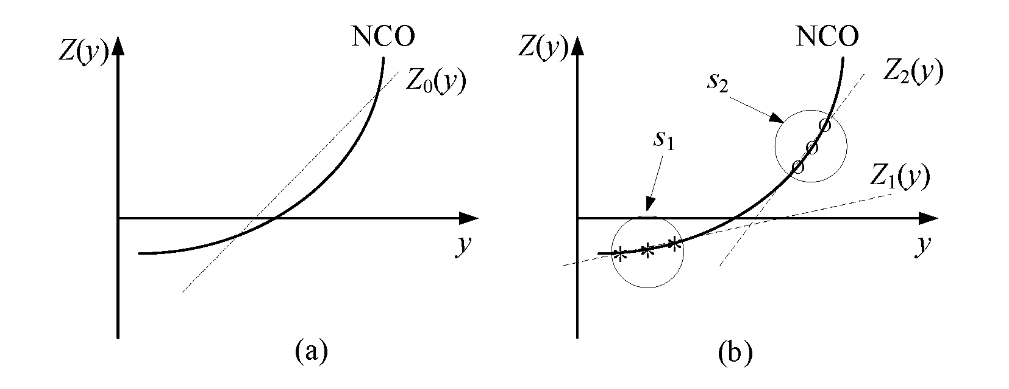
gSOC: CV adaptation
To avoid overfitting, simple CV function is preferable
Simple CV may result in small region for acceptable performance
Solution, update CV (adaptation) based on current operating point
Control system reconfiguration: CV, setpoint, and gain

Slide 11
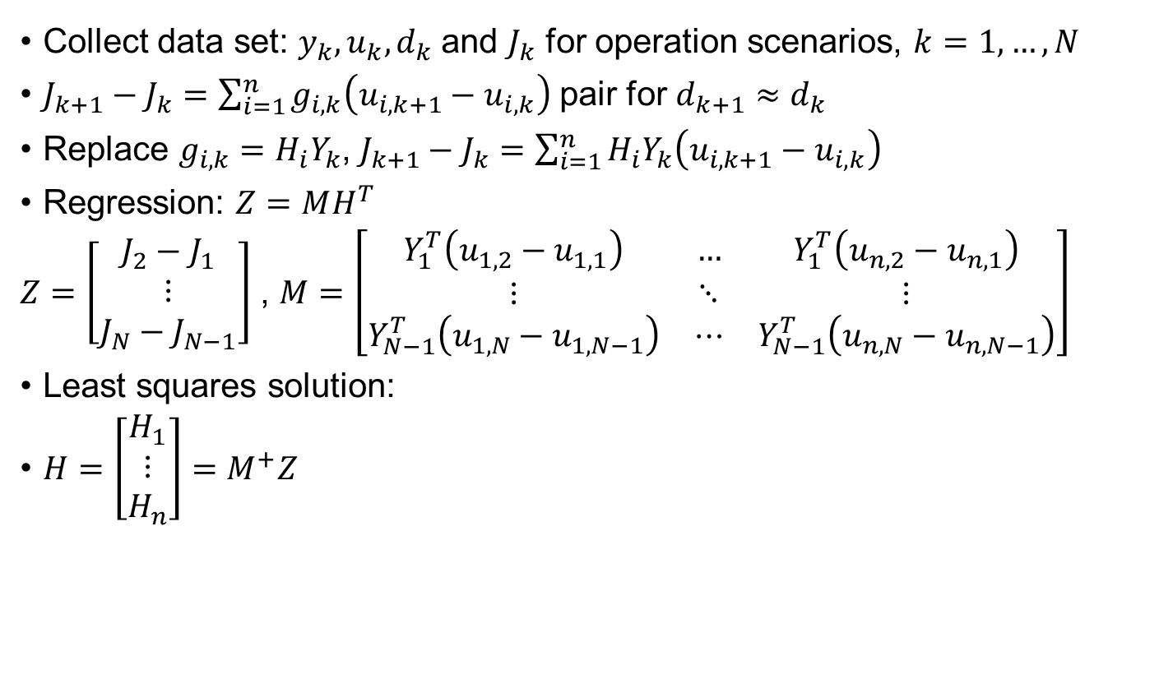
gSOC: data driven approach
Collect data set: $y_{k}, u_{k}, d_{k}$and $J_{k}$ for operation scenarios, $k=1,…,N$
$J_{k+1}−J_{k}=\sum_{i=1}^{n}{g_{i,k}\left(u_{i,k+1}−u_{i,k}\right)}$ pair for $d_{k+1}≈d_{k}$
Replace $g_{i,k}=H_{i}Y_{k}$, $J_{k+1}−J_{k}=\sum_{i=1}^{n}{H_{i}Y_{k}\left(u_{i,k+1}−u_{i,k}\right)}$
Regression: $Z=MH^{T}$
$Z=\left[\begin{matrix}J_{2}−J_{1} \\ ⋮ \\ J_{N}−J_{N−1}\end{matrix}\right]$ , $M=\left[\begin{matrix}Y_{1}^{T}\left(u_{1,2}−u_{1,1}\right) & … & Y_{1}^{T}\left(u_{n,2}−u_{n,1}\right) \\ ⋮ & ⋱ & ⋮ \\ Y_{N−1}^{T}\left(u_{1,N}−u_{1,N−1}\right) & ⋯ & Y_{N−1}^{T}\left(u_{n,N}−u_{n,N−1}\right)\end{matrix}\right]$
Least squares solution:
$H=\left[\begin{matrix}H_{1} \\ ⋮ \\ H_{n}\end{matrix}\right]=M^{+}Z$

Slide 12
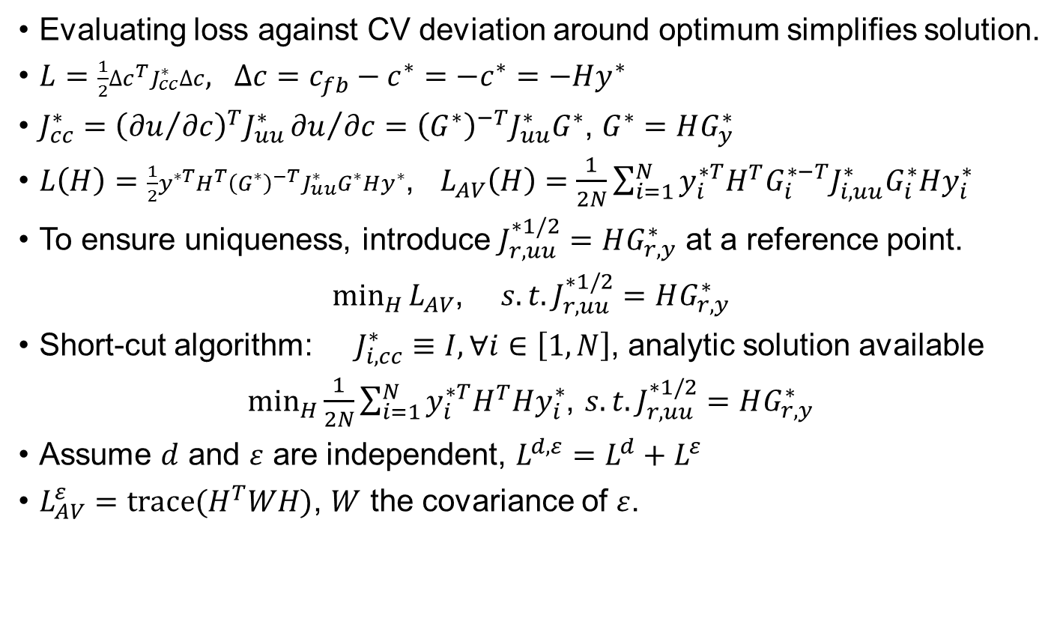
gSOC: optimal CV and short cut approaches
Evaluating loss against CV deviation around optimum simplifies solution.
$L=\frac{1}{2}{∆c}^{T}J_{cc}^{∗}∆c, ∆c=c_{fb}−c^{∗}=−c^{∗}=−Hy^{∗}$
$J_{cc}^{∗}={\left({∂u}/{∂c}\right)}^{T}J_{uu}^{∗}{∂u}/{∂c}={\left(G^{∗}\right)}^{−T}J_{uu}^{∗}G^{∗}$, $G^{∗}=HG_{y}^{∗}$
$L\left(H\right)=\frac{1}{2}y^{∗T}H^{T}{\left(G^{∗}\right)}^{−T}J_{uu}^{∗}G^{∗}Hy^{∗}$, $L_{AV}\left(H\right)=\frac{1}{2N}\sum_{i=1}^{N}{y_{i}^{∗T}H^{T}G_{i}^{∗−T}J_{i,uu}^{∗}G_{i}^{∗}Hy_{i}^{∗}}$
To ensure uniqueness, introduce $J_{r,uu}^{∗1/2}=HG_{r,y}^{∗}$ at a reference point.
$\min_{H}{L_{AV}}$, $s.t.J_{r,uu}^{∗1/2}=HG_{r,y}^{∗}$
Short-cut algorithm: $J_{i,cc}^{∗}≡I, ∀i∈\left[1,N\right]$, analytic solution available
$\min_{H}{\frac{1}{2N}\sum_{i=1}^{N}{y_{i}^{∗T}H^{T}Hy_{i}^{∗}}}$, $s.t.J_{r,uu}^{∗1/2}=HG_{r,y}^{∗}$
Assume $d$ and $ε$ are independent, $L^{d, ε}=L^{d}+L^{ε}$
$L_{AV}^{ε}=\text{trace}(H^{T}WH)$, $W$ the covariance of $ε$.

Slide 13
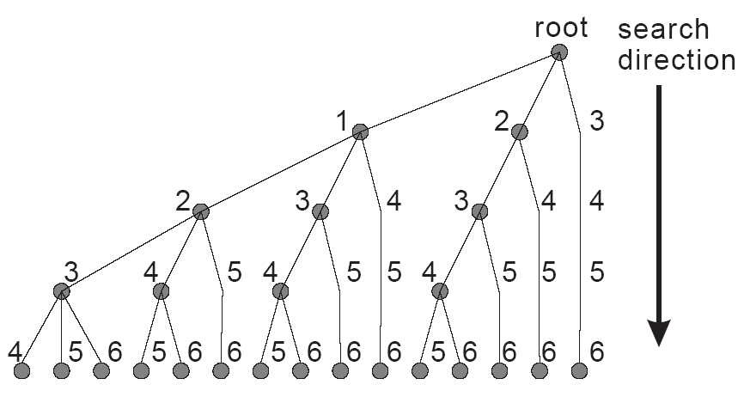




gSOC: subset selection
Minimum loss independent from H for a given set of measurements
Seek a small subset with similar performance but much simpler structure
Branch and bound algorithms are developed to solve selection problems
$$B≤\max_{X∈C∪D}{T(X)}$$
$$C$$
$$D$$
Prune
$$\max_{X∈C}{T(X)≤B}$$

Slide 14
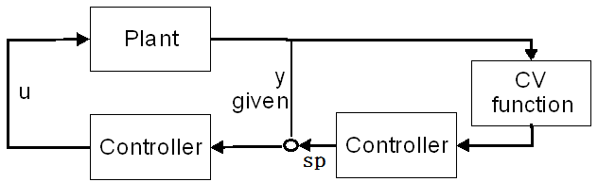
gSOC: retrofit SOC
Do we need to redesign the entire control system for SOC?
Retrofit SOC: control CVs selected by adjusting existing setpoints
Existing control system
Cascaded SOC
Advantages:
  Implementation does not need plant shut down
  Dynamic performance and constraints handling inherited
  gSOC to ensure best economic performance
  Subset selection to ensure simplest control structure
  Directly compatible with RTO
  Applicable to IoT

Slide 15
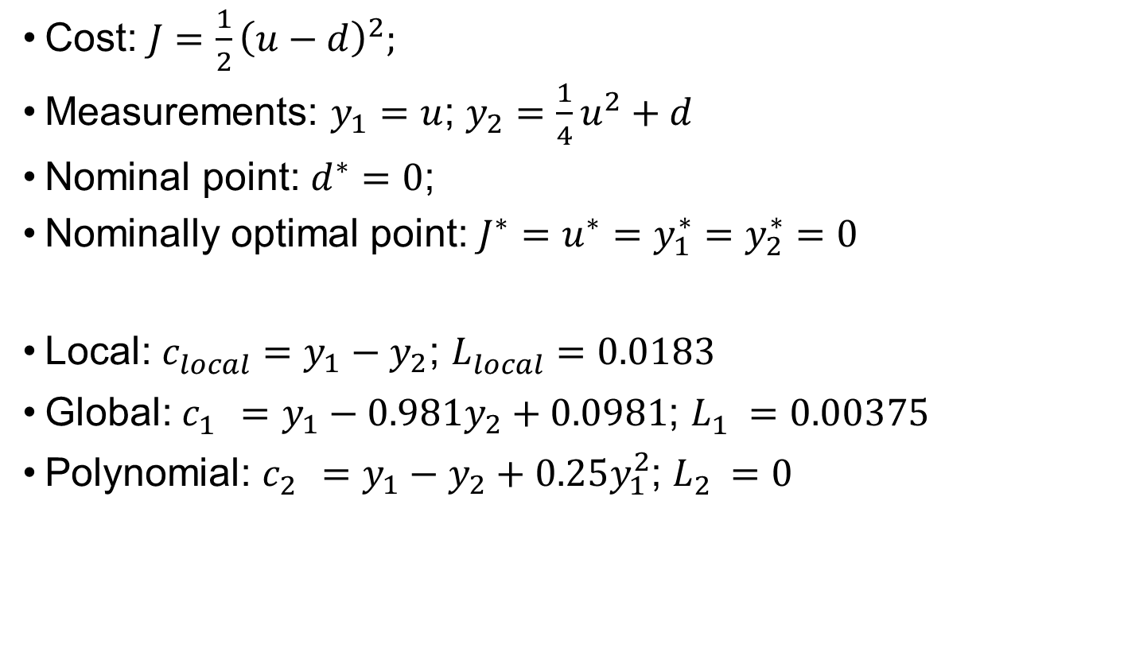
Toy Example
Cost: $J=\frac{1}{2}{\left(u−d\right)}^{2};$
Measurements: $y_{1}=u$; $y_{2}=\frac{1}{4}u^{2}+d$
Nominal point: $d^{∗}=0$;
Nominally optimal point: ${J^{∗}=u}^{∗}=y_{1}^{∗}=y_{2}^{∗}=0$
Local: $c_{local}^{}=y_{1}−y_{2}$; $L_{local}^{}=0.0183$
Global: $c_{1}^{}=y_{1}−{0.981y}_{2}+0.0981$; $L_{1}^{}=0.00375$
Polynomial: $c_{2}^{}=y_{1}−y_{2}+0.25y_{1}^{2}$; $L_{2}^{}=0$

Slide 16
Toy Example: NCO regression

Slide 17
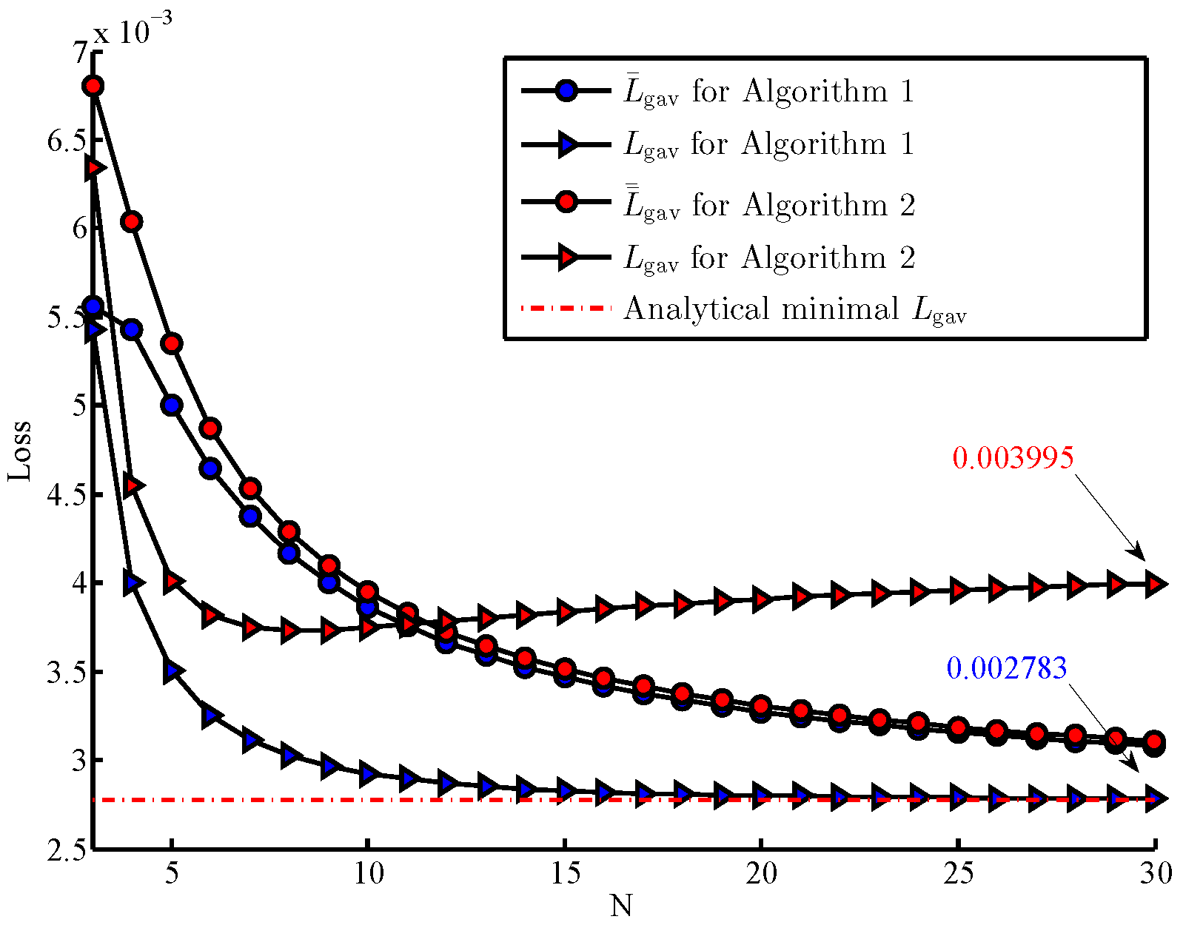
Toy example: optimal CV

Slide 18
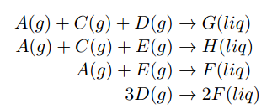
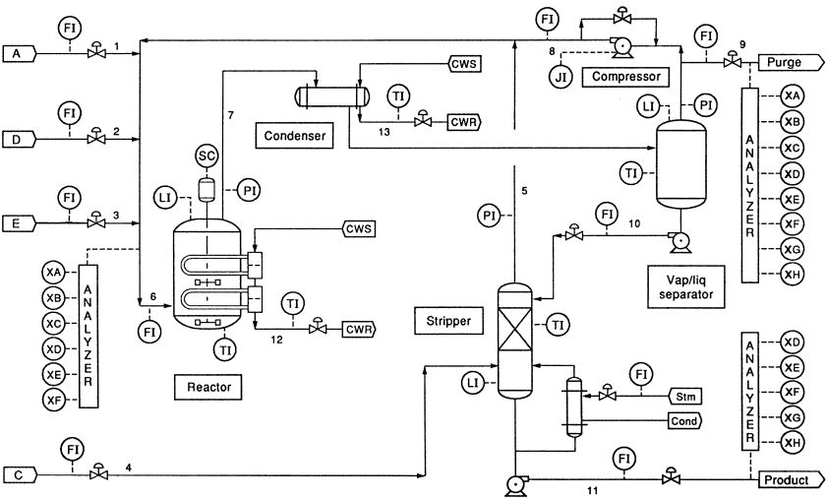
Retrofit SOC: TE Process
byproduct
Downs, J.J. and Vogel, E.F. (1993). A plant-wide industrial process control problem. Comput. Chem. Eng., 17(3), 245-255.
product

Slide 19
Retrofit SOC: operation optimization
Economic objective: minimize the cost
J=(loss of raw materials in purge and products) + (steam costs)+ (compression costs)
Various Constraints:
Product mixup (ratio of G:H), production rate
Reactor pressure, temperature
Vessel levels
MV saturations
etc
Degrees of freedom:
9 active constants: XMEAS(7,8,12,15,17,19,40), XMV(5,9,12)
3 DOF for SOC
Retrofit SOC adjust 3 set-points, y_{A}, y_{AC} and T_{rec}

Slide 20
Retrofit SOC: existing optimal control structures
1. Ricker, N. (1996), (CS_Ricker)
Nominal optimization + heuristic design
Decentralized control structure is available via http://depts.washington.edu/control/LARRY/TE/download.html
2. Larsson et. al. (2001), (CS_Skoge)
Individual measurement based SOC

Slide 21
Results and simulations
7 Operating conditions considered
  nominal
  IDV(1): A/C feed ratio
  IDV(2): B composition
  production rate ±15%
  product mix change: 50 G/50 H to 40 G/60 H
  step change of reactor pressure set-point to 2645 kPa

Slide 22
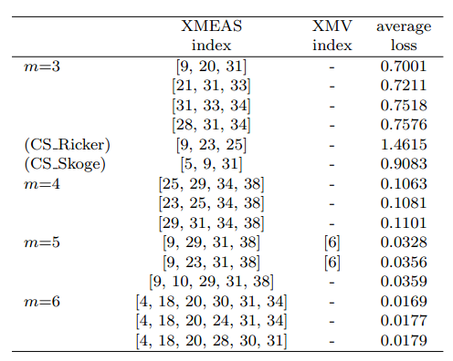
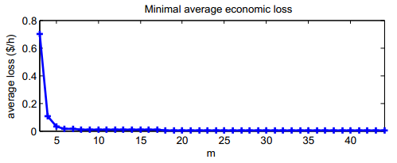
Minimal loss against subset size
XMEAS(>=23) : compositions

Slide 23
Simulation and Result economic loss
 | CS_Ricker | CS_Skoge | This work (m=3) | This work (m=6)
Nominal | 0 | 0 | 0.1 | 0.04
IDV(1) | 0 | 0.03 | 0.2 | 0.05
IDV(2) | 2.7 | 1.7 | 0.9 | 0
throughput +15% | 6.1 | 1.5 | 2.4 | 0.05
throughput -15% | 2.6 | 0.6 | 0.2 | 0.02
40 G/ 60 H | 0.7 | 0.3 | 0.5 | 0.01
rct press 2645 kPa | 0.3 | 4.5 | 1.3 | 0.01
sum | 12.4 | 8.63 | 5.6 | 0.23
Big loss

Slide 24
Conclusions and future works
gSOC minimising loss over entire operation region
Simulation data based approach, ready to use operation data directly
Normal operation data: NCO regression
RTO operation data: Optimal CV
Three extensions: subset selection, adaptation and retrofit
Future works
  Nonlinear measurement combinations
  Constrained SOC
  Dynamic SOC
  Reconfigurable SOC

