Slide 1


The Complex Braid of Communication and Control
Massimo Franceschetti

Slide 2

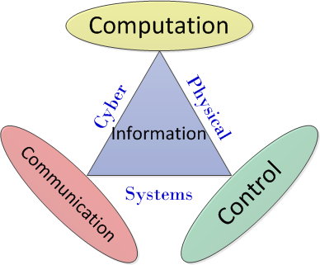

Motivation
January 2007
January 2012
Notes:
In the last decade, many authors have looked at the stabilization of dynamical systems over rate-limited feedback channels.
In general, all these works consider a scenario in which one or more dynamical systems need to be controlled or stabilized using multiple sensor and actuator that communicate over digital links with limited rate or on which packet may get lost.
The goal of this work is to characterize the trade-off between system instabilities and channel properties in the most general setup.

Slide 3
Motivation

Slide 4

Motivation

Slide 5

Motivation

Slide 6
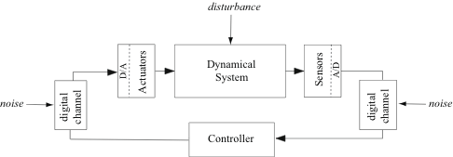
Abstraction
Channel quality
Time

Slide 7


Problem formulation
Linear dynamical system
A composed of unstable modes
Time-varying channel
Slotted time-varying channel evolving at the same time scale of the system

Slide 8


Problem formulation
Objective: identify the trade-off between system’s unstable modes and channel’s rate to guarantee stability:

Slide 9

Information-theoretic approach
A rate-based approach, transmit
Derive data-rate theorems quantifying how much rate is needed to construct a stabilizing quantizer/controller pair
Rate
Time

Slide 10
Network-theoretic approach
A packet-based approach (a packet models a real number)
Determine the critical packet loss probability above which the system cannot be stabilized by any control scheme
Rate
Time

Slide 11



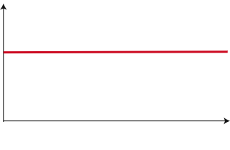
Information-theoretic approach
Tatikonda-Mitter (IEEE-TAC 2002)
Rate process: known at the transmitter
Disturbances and initial state support: bounded
Data rate theorem:
a.s. stability
Rate
Time
Generalizes to vector case as:

Slide 12
Information-theoretic approach
Nair-Evans (SIAM-JCO 2004)
Rate process: known at the transmitter
Disturbances and initial state support: unbounded
Bounded higher moment (e.g. Gaussian distribution)
Data rate theorem:
Second moment stability
Rate
Generalizes to vector case as:
Time

Slide 13



Intuition
Want to compensate for the expansion of the state during the communication process
At each time step, the uncertainty volume of the state
Keep the product less than one for second moment stability
State variance
instability
R-bit message

Slide 14



Information-theoretic approach
Martins-Dahleh-Elia (IEEE-TAC 2006)
Rate process: i.i.d process distributed as R
Disturbances and initial state support: bounded
Causal knowledge channel: coder and decoder have knowledge of
Data rate theorem:
Second moment stability
Rate
Scalar case only
Time

Slide 15

Intuition
At each time step, the uncertainty volume of the state
Keep the average of the product less than one for second moment stability
State variance
Rate R₁
Rate R₂

Slide 16
Information-theoretic approach
Minero-F-Dey-Nair (IEEE-TAC 2009)
Rate process: i.i.d process distributed as R
Disturbances and initial state support: unbounded
Bounded higher moment (e.g. Gaussian distribution)
Causal knowledge channel: coder and decoder have knowledge of
Data rate theorem:
Second moment stability
Rate
Time
Vector case, necessary and sufficient conditions almost tight

Slide 17
Proofs
Necessity: Based on entropy power inequality and maximum entropy theorem
Sufficiency: Difficulty is in the unbounded support, uncertainty about the state cannot be confined in any bounded interval, design an adaptive quantizer to avoid saturation, achieve high resolution through successive refinements.

Slide 18

Network-theoretic approach
A packet-based approach (a packet models a real number)
Rate
Time

Slide 19


Critical dropout probability
Sinopoli-Schenato-F-Sastry-Poolla-Jordan (IEEE-TAC 2004)
Gupta-Murray-Hassibi (System-Control-Letters 2007)
Elia (System-Control-Letters 2005)
Rate
Time
Generalizes to vector case as:

Slide 20


Critical dropout probability
Can be viewed as a special case of the information-theoretic approach
Gaussian disturbance requires unbounded support data rate theorem of Minero, F, Dey, Nair, (2009) to recover the result

Slide 21

Stabilization over channels with memory
Gupta-Martins-Baras (IEEE-TAC 2009)
Network theoretic approach
Two-state Markov chain
Critical “recovery probability”

Slide 22

Stabilization over channels with memory
You-Xie (IEEE-TAC 2010)
Information-theoretic approach
Two-state Markov chain, fixed R or zero rate
Disturbances and initial state support: unbounded
Let T be the excursion time of state R
Data-rate theorem
For recover the critical probability

Slide 23


Stabilization over channels with memory
Minero-Coviello-F (IEEE-TAC to appear)
Information-theoretic approach
Disturbances and initial state support: unbounded
Time-varying rate
Arbitrary positively recurrent time-invariant Markov chain of n states
Obtain a general data rate theorem that recovers all previous results using the theory of Jump Linear Systems

Slide 24


Markov Jump Linear System
Define an auxiliary dynamical system (MJLS)
State variance
Rate r_{k}

Slide 25

Markov Jump Linear System
Let H be the matrix defined by the transition probabilities and the rates
Let be the spectral radius of H
The MJLS is mean square stable iff
Relate the stability of MJLS to the stabilizability of our system

Slide 26

Data rate theorem
Stabilization in mean square sense over Markov time-varying channels is possible if and only if the corresponding MJLS is mean square stable, that is:

Slide 27




Previous results as special cases

Slide 28


What next
Is this the end of the journey?
No! journey is still wide open
… introducing noisy channels

Slide 29







Insufficiency of Shannon capacity
Sahai-Mitter (IEEE-IT 2006)
Example: i.i.d. erasure channel
Data rate theorem:
Shannon capacity:

Slide 30





Capacity with stronger reliability constraints
Shannon capacity soft reliability constraint
Zero-error capacity hard reliability constraint
Anytime capacity medium reliability constraint

Slide 31



Alternative formulations
Undisturbed systems
Tatikonda-Mitter (IEEE-AC 2004)
Matveev-Savkin (SIAM-JCO 2007)
a.s. stability
Disturbed systems (bounded)
Matveev-Savkin (IJC 2007)
a.s. stability
Sahai-Mitter (IEEE-IT 2006)
moment stability
Anytime reliable codes: Shulman (1996), Ostrovsky, Rabani, Schulman (2009), Como, Fagnani, Zampieri (2010), Sukhavasi, Hassibi (2011)

Slide 32
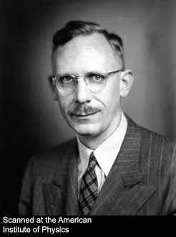

The Bode-Shannon connection
Connection with the capacity of channels with feedback
Elia (IEEE-TAC 2004)
Ardestanizadeh-F (IEEE-TAC 2012)
Ardestanizadeh-Minero-F (IEEE-IT 2012)

Slide 33



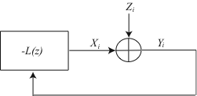
Control over a Gaussian channel
Instability
Power constraint
Complementary sensitivity function
Stationary (colored) Gaussian noise

Slide 34



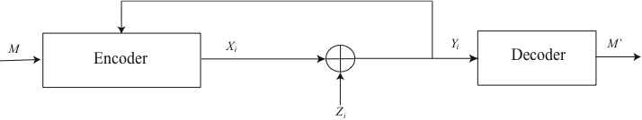
Control over a Gaussian channel
Power constraint
Feedback capacity
The largest instability U over all LTI systems that can be stabilized by unit feedback over the stationary Gaussian channel, with power constraint P corresponds to the Shannon capacity C_{F} of the stationary Gaussian channel with feedback [Kim(2010)] with the same power constraint P.

Slide 35
Communication using control
This duality between control and feedback communication for Gaussian channels can be exploited to design communication schemes using control tools
MAC, broadcast channels with feedback
Elia (IEEE-TAC 2004)
Ardestanizadeh-Minero-F (IEEE-IT 2012)

Slide 36

Conclusion
Data-rate theorems for stabilization over time-varying rate channels, after a beautiful journey of about a decade, are by now fairly well understood
The journey (quest) for noisy channels is still going on
The terrible thing about the quest for truth is that you may find it
For papers: www.circuit.ucsd.edu/~massimo/papers.html

